Slide 1

Real Estate Data Analytics with Power BI
Transforming raw real estate data into actionable insights for strategic decision-making.

Slide 2
Project Overview: From Chaos to Clarity
1
2
3
Project Goal
Key Objective
Tools Utilized
To convert fragmented, unclean real estate data into a cohesive, insightful analytics platform.
Deliver a robust Power BI solution that empowers data-driven decisions in real estate.
Leveraged Excel for initial data handling, Power Query for transformation, DAX for calculations, and Power BI for visualization.

Slide 3

Addressing the Business Challenge: Data Disarray
Fragmented Data Sources
Inconsistent Data Quality
Lack of Centralized Insights
Real estate information was siloed across numerous disparate Excel sheets, hindering a holistic view.
Significant issues with inconsistent formats, missing values, and duplicate records plagued the dataset.
Absence of a unified dashboard meant critical business insights were unattainable, slowing decision-making.

Slide 4

Dataset Landscape: Understanding the Raw Material
Multi-Sheet Complexity
Extensive Records
Over 10,000 property records, each with various attributes requiring meticulous attention.
Dataset comprised 5 distinct sheets: Properties, Agents, Offices, Owners, and Neighborhoods.
Diverse Data Challenges
Encountered mixed data formats, prevalent null values, and broken relationships between tables.

Slide 5

My Contribution: Driving Data Transformation
01
Analyzed Raw Data
Conducted a thorough analysis of the multi-sheet dataset to identify inconsistencies and pain points.
02
Cleaned & Standardized
Implemented rigorous data cleaning and standardization procedures across all relevant fields.
03
Developed Data Model
Constructed an efficient data model, establishing robust relationships between diverse tables.
04
Created Interactive Dashboards
Designed and built intuitive Power BI dashboards with key performance indicators (KPIs).

Slide 6


Data Cleaning in Action: Step-by-Step Transformations
Eliminated Redundancy
Systematically removed blank rows and duplicate records to ensure data integrity.
Addressed Null Values
Strategically handled missing data by either replacing with appropriate defaults or removing them based on context.
Standardized Text Formats
Applied consistent text casing (e.g., Proper Case for names) to enhance readability and consistency.
Corrected Date Formats
Ensured all date fields were in a uniform, analyzable format for accurate temporal insights.
Resolved Category Inconsistencies
Standardized 'Property Type' and 'Listing Type' categories to enable consistent filtering and analysis.

Slide 7

Power Query Editor: My Data Cleaning Workbench
Column Profiling
Utilized Power Query's profiling tools to identify nulls, errors, and duplicates at a glance.
Value Replacement
Employed 'Replace Values' and 'Conditional Columns' for precise data manipulation and correction.
Data Type Validation
Strictly enforced correct data types (Text, Number, Date) to prevent calculation errors and ensure accuracy.
Foreign Key Validation
Performed thorough validation of foreign keys across tables to guarantee robust data relationships.

Slide 8

Data Modeling & Key Performance Indicators (KPIs)
Star Schema Model
Implemented a star schema with 'Properties' as the central Fact table.
Dimension Tables
Developed comprehensive dimension tables for Agents, Offices, Owners, and Neighborhoods.
Calculated KPIs
Average Property Price
Total Listings
Listing Conversion Rate
Agent Performance Score

Slide 9

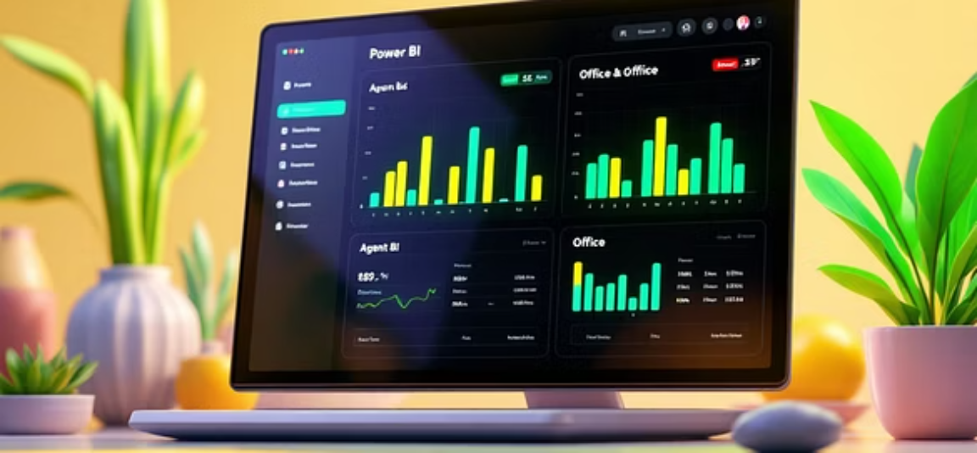




Interactive Dashboards: Unlocking Real Estate Insights
Property Pricing Trends
Agent & Office Performance
Neighborhood Analysis
Visualized property pricing dynamics by city and over time, highlighting market shifts.
Compared agent and office metrics to identify top performers and areas for improvement.
Delved into neighborhood data, including income levels, crime rates, and property ratings, for informed investment decisions.

Slide 10

Conclusion: Driving Impact Through Data
"This project exemplifies my ability to transform complex, disparate data into a powerful, user-friendly analytical tool. I am adept at the full data lifecycle, from meticulous cleaning to strategic visualization, and I am confident in my capacity to deliver significant value to your team."
Reliable Data Foundation
Centralized Intelligence
Delivered a clean, accurate, and analytics-ready dataset.
Provided management with a single source of truth through a dynamic Power BI dashboard.
Enhanced Decision-Making
Enabled data-driven strategies, improving performance tracking and operational efficiency.

